Slide 1


AMAZON SALES
MICROSOFT POWER BI AND SQL
Vrindha Unni

Slide 2
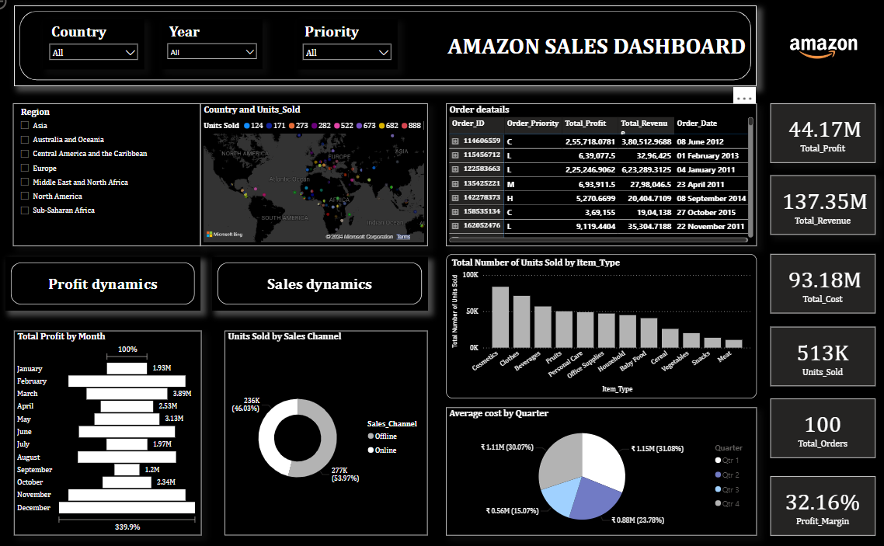
POWER BI DASHBOARD

Slide 3

Problem Statement:
Sales management has emerged as the cornerstone of commercial enterprises, essential for navigating market competition and optimizing distribution channels. To address this, I conducted an in-depth analysis of Amazon sales data to uncover sales trends, identify key metrics, and establish meaningful relationships between attributes.

Slide 4



KEY PERFORMANCE INDICATORS
REVENUE
Sales revenue generated by Amazon, providing high-level vie w of overall business
PROFIT MARGIN
The ratio of net profit to total revenue , indicating the financial efficiency and profitability
NO OF PRODUCTS SOLD
Tracking the product sales to provide valuable insights into demand and trends

Slide 5
STATISTIC
44M +
TOTAL PROFIT
Total profit is a fundamental measure in assessing the financial health and performance of an entity, indicating its ability to generate surplus revenue beyond incurred expenses
70 +
COUNTRIES
The sales data across these countries provides invaluable customer behaviour, market trends and economics dynamics
10+
PRODUCTS
Product categories represents a diverse range of consumer interests and preference.
500K+
UNITS SOLD
This category will specify the customer satisfaction, market trends to the product.

Slide 6
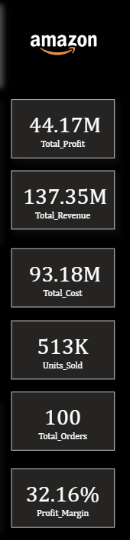
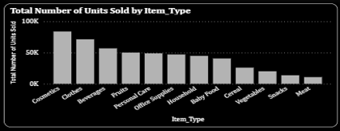
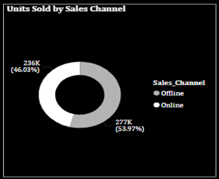
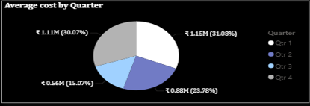
INSIGHT:
The total sales is $137.35 million out of which total profit is $44.17 million.
The average profit margin and unit sold are $32.16 and $276.76 respectively.
“Cosmetics” products gave the highest sales.
The units sold more using offline channel.
Cosmetic products are very popular among people of Europe and these products generated the highest profit ($14.56 million) of all items. So, it is advisable to create some marketing campaigns promoting Cosmetic products.
The year 2010 and 2017 has seen lowest number of orders.
The lowest rate of profit margin is in North American region and highest in Middle East and North Africa
The Sub-Saharan Africa region has seen the highest sales
PRODUCT INSIGHTS
REGION INSIGHTS

Slide 7
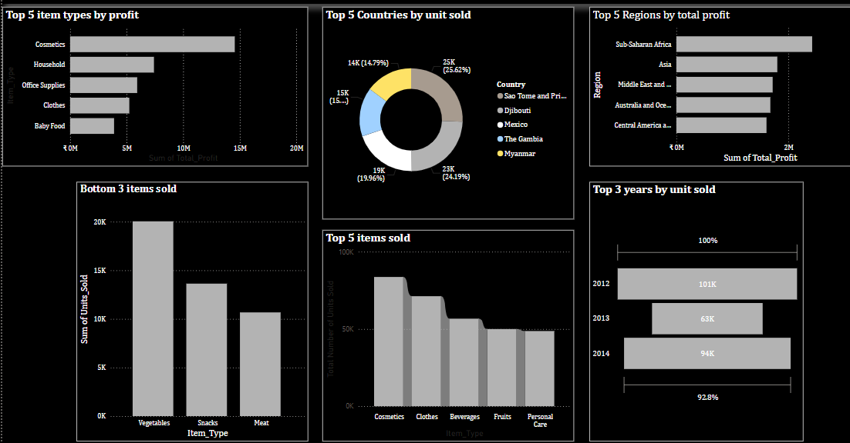
SALES ANALYSIS
“Cosmetics” products gave the highest profit and sales.
The year 2012 has seen the highest sales.
The office supply is more in Russia , Australia and Mauritania
The Country Sao Tome and Principe has highest sales.
The Sub-Saharan Africa region has seen the highest profit
The high priority items sold for offline channel.
The Meat product gave the least sales and profit.
There is no online sales channel for the Region of North America, indicating a higher focus on in-store distribution.

Slide 8
CONCLUSION
Gain actionable insights to drive informed decision-making and optimize sales performance on Amazon.
Identify growth opportunities, streamline operations, and enhance profitability with data-driven strategies

